Slide 1
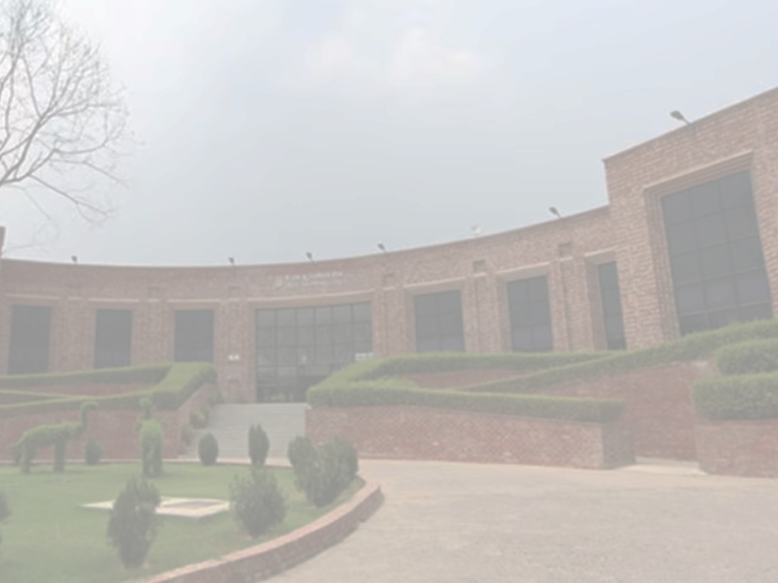





3rd International Conference on Recent Advances in Nanoscience and Nanotechnology-2025 (ICRANN-2025)
December 20-21, 2025
Special Centre for Nanoscience (SCNS)
Jawaharlal Nehru University (JNU), New Delhi-67
Paper ID
xxxx
Title of the paper (28 Font) All Authors’ Name (14 Font)
Name of the Presenter (16 Font)
(Email id of the Presenter (12 Font) )
Logo of your Institute
Name of the Department of the presenter,
Institute Name
Address of Institute
ICRANN-2025 : December 20-21, 2025

Slide 2
Flow of Presentation:
General Instructions:
The total number of slides can not be more than 10 excluding Title & Thank you slide.
You are expected to spend minimum 30 seconds to 1 minute per slide.
Total duration of your presentation should be maximum of 10 minutes followed by 4 minutes QA session.
Please mention novelty in your work, especially in the Conclusion slide.
Submission of the Slides:
A google form will be filled by the presenter.
The link for the google form will be provided in due course of time.
Name of the presenter
ICRANN-2025 : December 20-21, 2025

Slide 3
Motivation:
Name of the presenter
ICRANN-2025 : December 20-21, 2025

Slide 4
Objective:
Name of the presenter
ICRANN-2025 : December 20-21, 2025

Slide 5
Analysis:
Name of the presenter
ICRANN-2025 : December 20-21, 2025

Slide 6
Key Results:
Name of the presenter
ICRANN-2025 : December 20-21, 2025

Slide 7
Conclusions:
Name of the presenter
ICRANN-2025 : December 20-21, 2025

Slide 8
Thank You.
Question Please!!!
ICRANN-2025 : December 20-21, 2025

